Slide 1
Cortex-M0 Programming (II)

Slide 2
Running C program on NUC140
To run C program on NUC140, you need to know
CMSIS.
NUC140 features
memory map
peripheral programming information
More details can be found in
“Chapter-4---Introduction-to-Cortex-M0 Programming.pdf”
“NuMicro™ NUC100 Series NUC130/NUC140 Technical Reference Manual”, 573 pages.
2

Slide 3
CMSIS
ARM provides the Cortex Microcontroller Software Interface Standard (CMSIS) for programming Cortex-M0 microcontrollers.
The CMSIS is an integrated part of the device driver library.
For a Cortex-M0 microcontroller system, CMSIS defines:
a common way to:
— access peripheral registers
— define exception vectors
the names of:
— the registers of the core peripherals
— the core exception vectors
a device-independent interface for RTOS kernels.
3

Slide 4
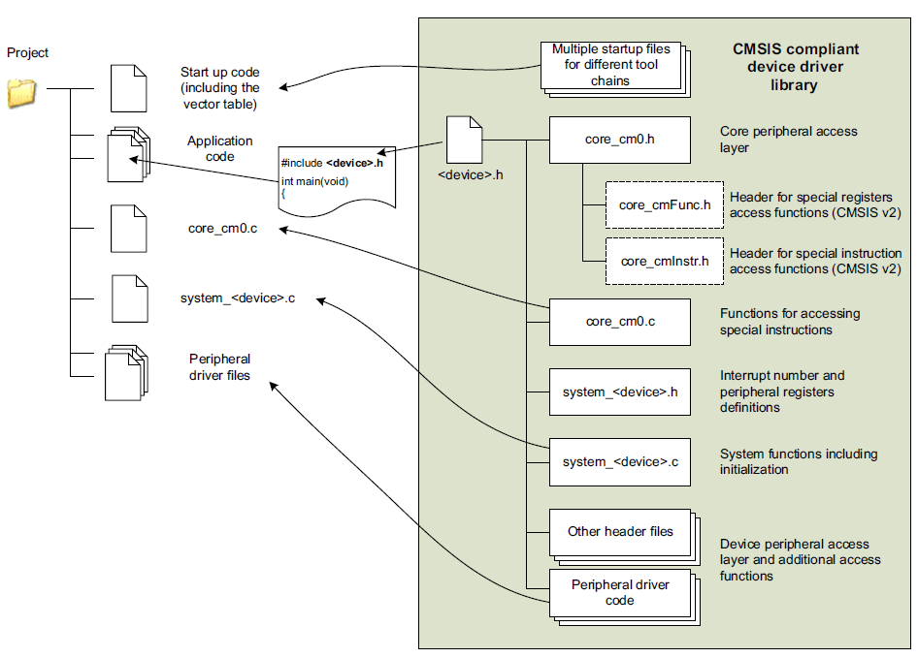
Using CMSIS in a project
4

Slide 5
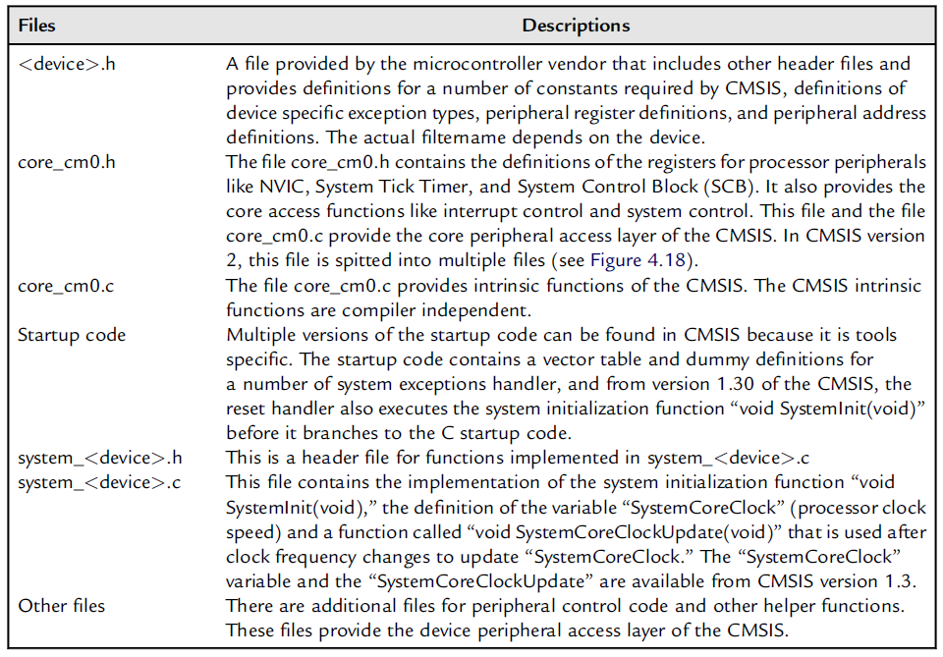
Files in CMSIS
5

Slide 6
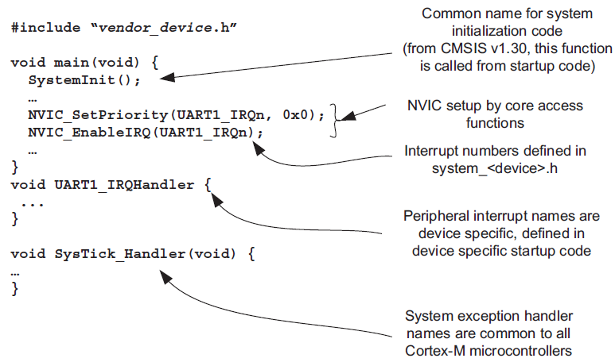
A CMSIS Example
6

Slide 7
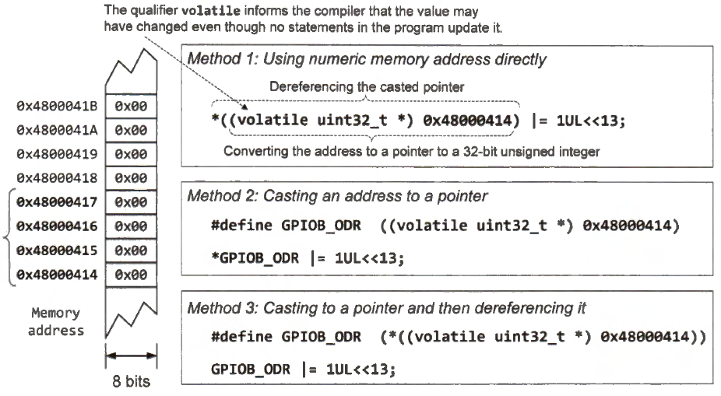
Casting a memory address to a pointer
There are three ways to cast a memory address to a pointer.
7

Slide 8
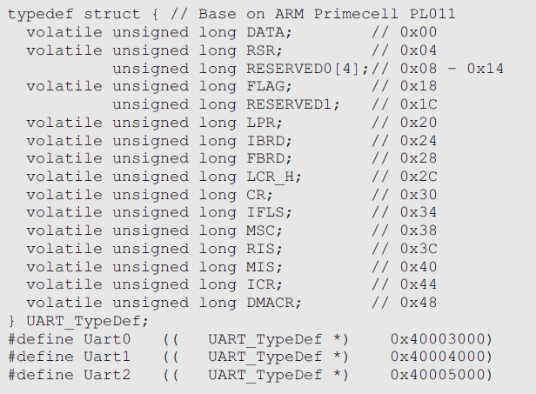
Example registers definition for a UART
Define the peripheral register set as a data structure and define the peripheral as a memory pointer to this data structure.
With this arrangement, the same register data structure for the peripheral can be shared between multiple instantiations.
8

Slide 9
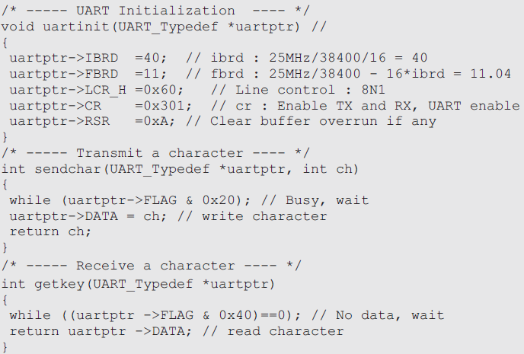
Control registers definition for a UART
A function developed for the peripherals can be shared between multiple units by passing the base pointer to the function.
9

Slide 10
NUC140 Features
ARM® Cortex™-M0 core
Running up to 50MHz
Single-cycle 32-bit Multiplier
32 external interrupt inputs, each with four levels of priority
Serial Wire Debug support with 2 watch points/4 break points
Flash EPROM Memory
128KB Flash EPROM for program code
Configurable data flash address and size
Support 2 wire ICP update through SWD/ICE
16KB embedded SRAM
4KB ISP loader Flash
Peripheral Interfaces
UART : 3 ports, 1Mbps, 16 bytes FIFO
I2C : 2 ports, master 1MHz, slave 1MHz
SPI : 4 ports,master 32Mz, slave 16MHz
ACMP : 2 ports
ADC : 8 channels, 12-bit @1M SPS
PWM : 8 channels
RTC
Power Management
Operating Voltage: 2.5V ~ 5.5V
Operating Temperature :-40℃~85℃
Power-Down mode supported
Brow-out Detector (4 levels: 4.5/3.8/2./2.2V)
Low Voltage Reset
Peripheral Bus
USB2.0 FS
LIN bus
CAN2.0b
Code Protection
Lock bit for firmware protection
96-bit UID unique chip ID
128-bit UCID unique customer ID
Clock Sources
4 ~ 24MHz external crystal, builtin PLL, 32.768KHz external crystal, 12/16MHz internal RC oscillator, 10KHz internal RC oscillator
Package
LQFP48 (7x7),LQFP64 (10x10), LQFP100(14x14)
10

Slide 11
NUC140 MCU block diagram
Designed by ARM
Designed by chip manufacture (Nuvoton)
ARM
Cortex-M0
50MHz
Memory
ARPOM 128KB
LDROM 4KB
SRAM 16KB
Data Flash shared with APROM
PDMA
9-ch
Power
Control
LDO
2.5~5.5V
POR
LVR
BOR
Timer/PWM
32b Timer x4
WDT
RTC
PWM x8
Analog Interface
12b ADC x8
ACMP x2
AHB bus
Bridge
APB bus
Clock Control
External Hi 4~24MHz
External Lo 32.768KHz
Internal Hi OSC 12/16M
Internal Lo OSC 10KHz
Connectivity/GPIO
GPIOs
UART x3
LIN bus
USB 2.0
CAN 2.0b
Peripheral Interfaces
SPI x4
I2C x2
I2S x1
Designed by chip manufacture (Nuvoton)
11

Slide 12
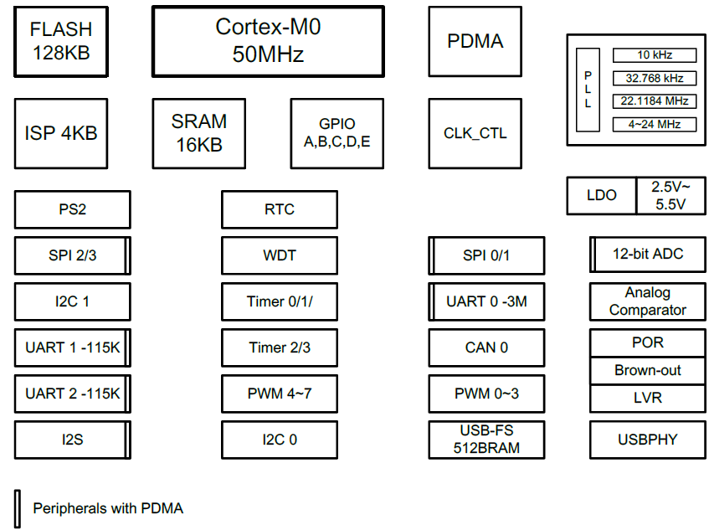
Block Diagram
12

Slide 13
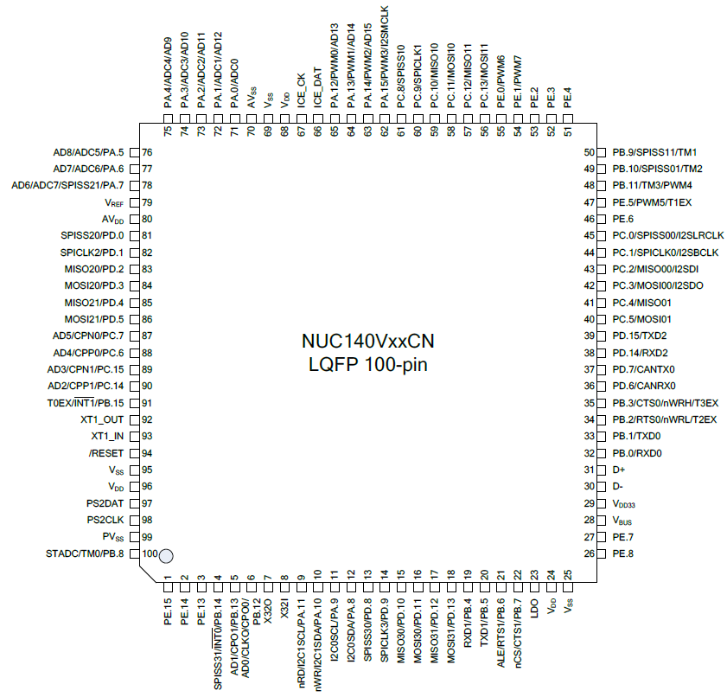
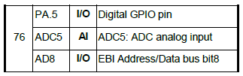
pin 76 controls the 3rd row of keypad, and the ADC5, how can this be done?
13

Slide 14
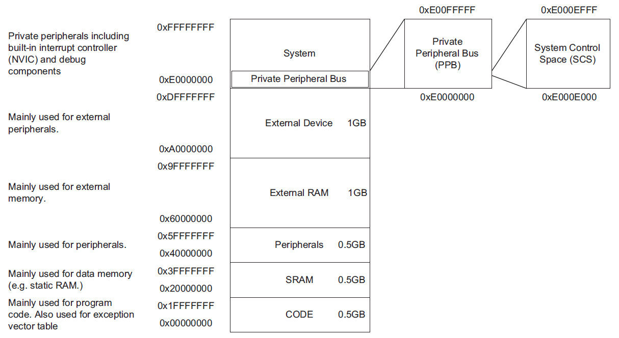
Memory Map (revisited)
Please also check the “System Memory Map” on page 52 of NUC140_Technical_Reference_Manual_EN_Rev2.05.pdf
14

Slide 15
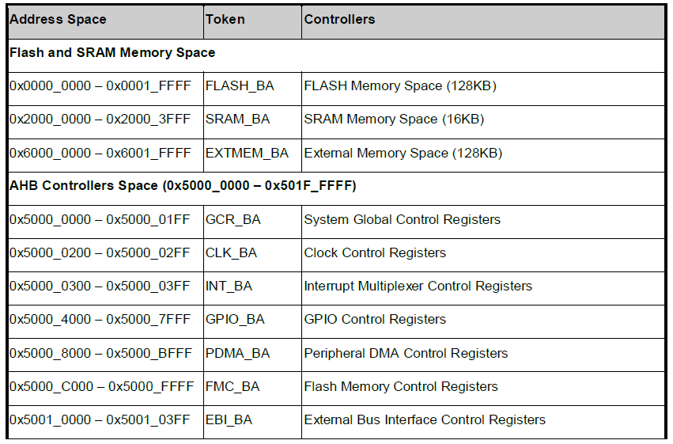
Peripheral Programming
Many microcontrollers offer digital and analog inputs and outputs (I/Os), UARTs, I2C, SPI, USB, CAN, and graphics LCD, interfaces. These interfaces are handled by peripherals in the microcontrollers.
On Cortex-M0 microcontrollers, peripherals are controlled by memory-mapped registers
15

Slide 16
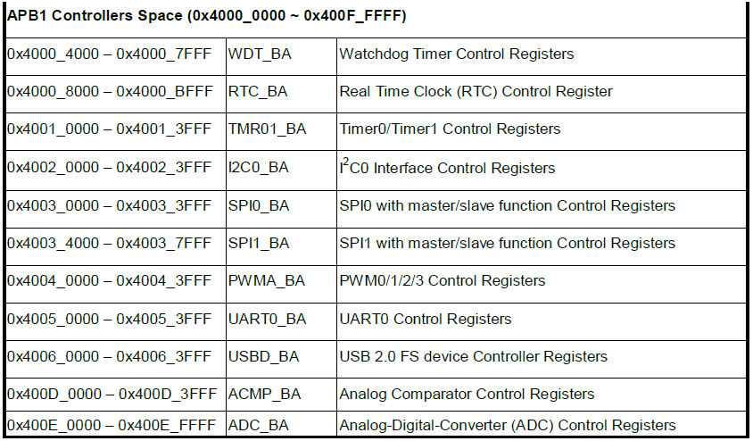
Peripheral Programming
16

Slide 17
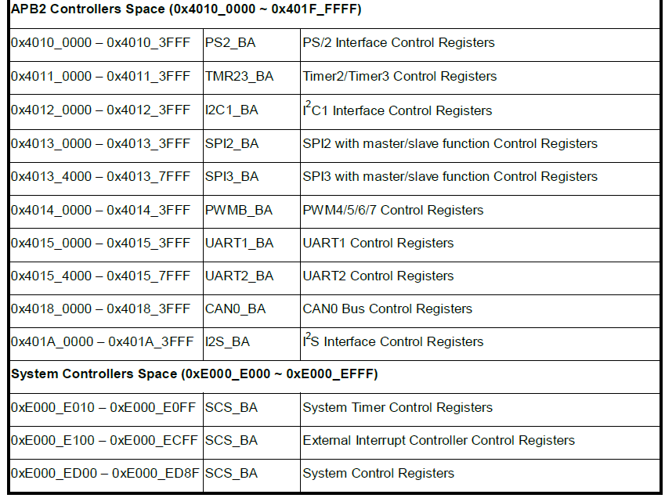
Peripheral Programming
17

Slide 18
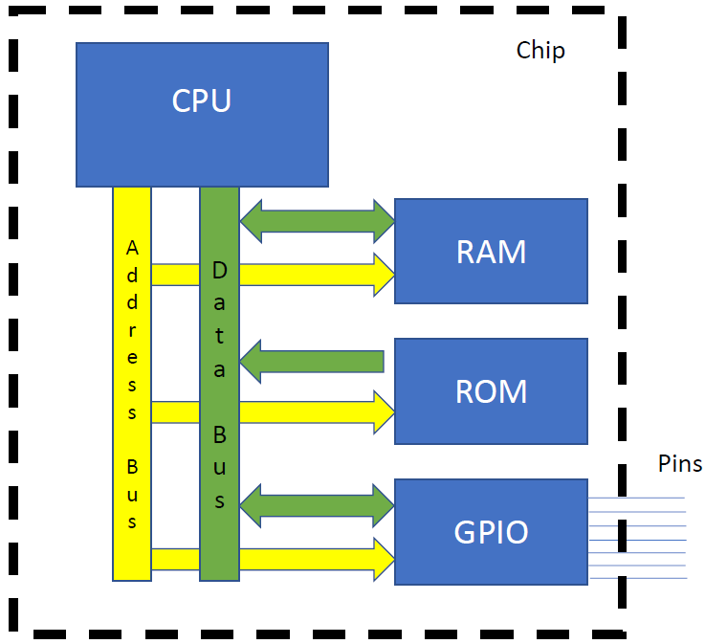
General MCU Interfacing (Revisited)
CPU needs to talk to RAM
(read/write variables)
Read from ROM
How do I drive/read these pins?
CPU will write stuff to them (like to blink and LED)
CPU will read stuff from them (like a button push).
18

Slide 19
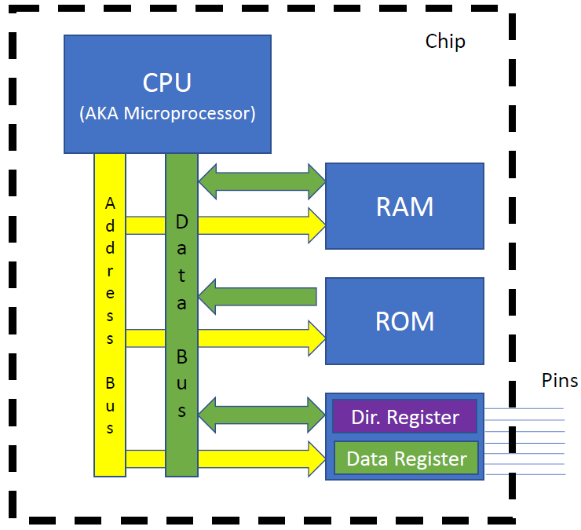
General MCU Interfacing
There is an on-chip module outside the CPU that contains “registers”
One drives the direction of the pins
The other stores the data
CPU accesses these registers through LDR/STR instructions.
Certain memory addresses correspond to each register.
19

Slide 20
NUC140 General Purpose I/O (GPIO)
“NUC140_Technical_Reference_Manual_EN_Rev2.05.pdf”, pp.177
The NUC140 has up to 80 General Purpose I/O pins that can be shared with other function pins depending on the chip configuration.
These 80 pins are arranged in 5 ports named with GPIOA, GPIOB, GPIOC, GPIOD and GPIOE. Each port has maximum 16 pins.
Each GPIO pin can be set as chip interrupt source by setting correlative GPIOx_IEN bit and GPIOx_IMD.
There are four types of interrupt condition can be selected: low level trigger, high level trigger, falling edge trigger and rising edge trigger.
20

Slide 21
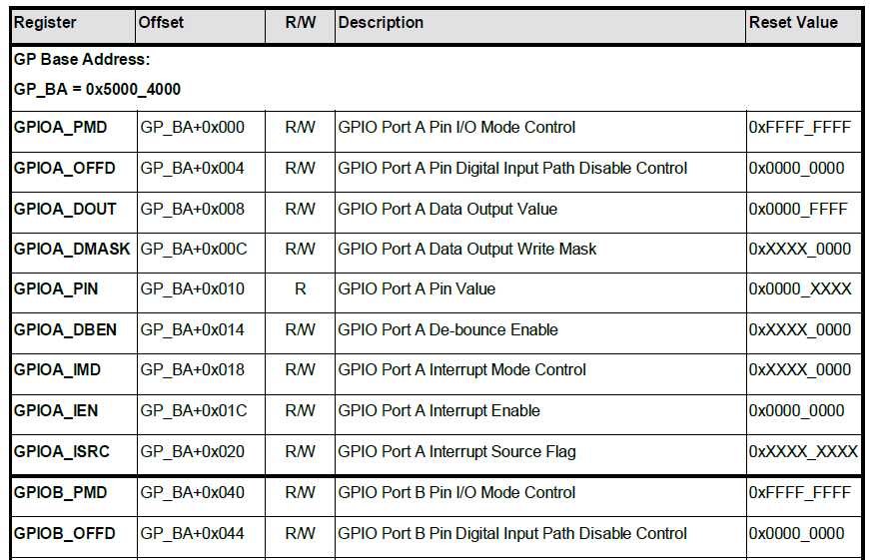
GPIO Register Map
…….
(PB, PC, PD, PE)
21

Slide 22
NUC140 Timer Controller (TMR)
“NUC140_Technical_Reference_Manual_EN_Rev2.05.pdf”, pp.309
The timer controller includes four 32-bit timers, TIMER0~TIMER3
The timer can perform functions like frequency measurement, event counting, interval measurement, clock generation, delay timing and so on.
The timer can generate an interrupt signal upon timeout, or provide the current value during operation
22

Slide 23
Nested Vectored Interrupt Controller (NVIC)
“NUC140_Technical_Reference_Manual_EN_Rev2.05.pdf”, pp.94
The Cortex-M0 provides an interrupt controller as an integral part of the exception mode, named as “Nested Vectored Interrupt Controller (NVIC)”.
It is closely coupled to the processor kernel and provides following features:
Nested and Vectored interrupt support
Automatic processor state saving and restoration
Reduced and deterministic interrupt latency
The NVIC prioritizes and handles all supported exceptions. All exceptions are handled in “Handler Mode”.
This NVIC architecture supports 32 (IRQ[31:0]) discrete interrupts with 4 levels of priority. All of the interrupts and most of the system exceptions can be configured to different priority levels.
When an interrupt occurs, the NVIC will compare the priority of the new interrupt to the current running one’s priority. If the priority of the new interrupt is higher than the current one, the new interrupt handler will override the current handler.
23

Slide 24
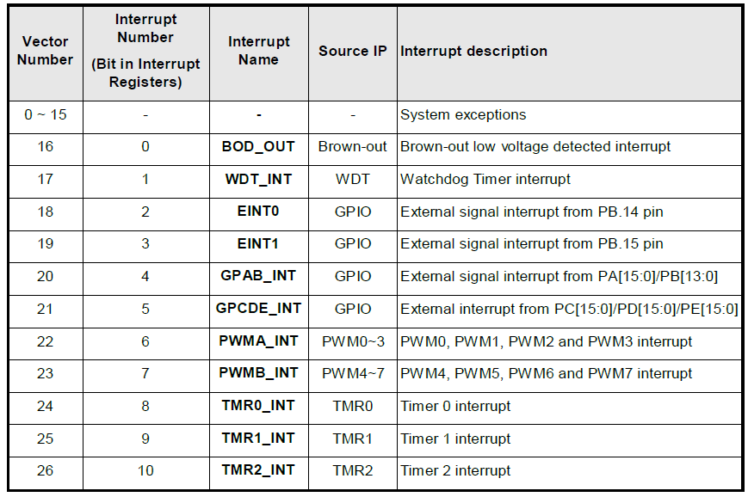
NUC140 System Interrupt Map
When any interrupts is accepted, the starting address of the interrupt service routine (ISR) is fetched from a vector table in memory. (There is no need to determine which interrupt is accepted and branch to the starting address of the correlated ISR by software.)
While the starting address is fetched, NVIC will also automatically save processor state including the registers “PC, PSR, LR, R0~R3, R12” to the stack.
At the end of the ISR, the NVIC will restore the mentioned registers from stack and resume the normal execution. Thus it will take less and deterministic time to process the interrupt request.
24

Slide 25
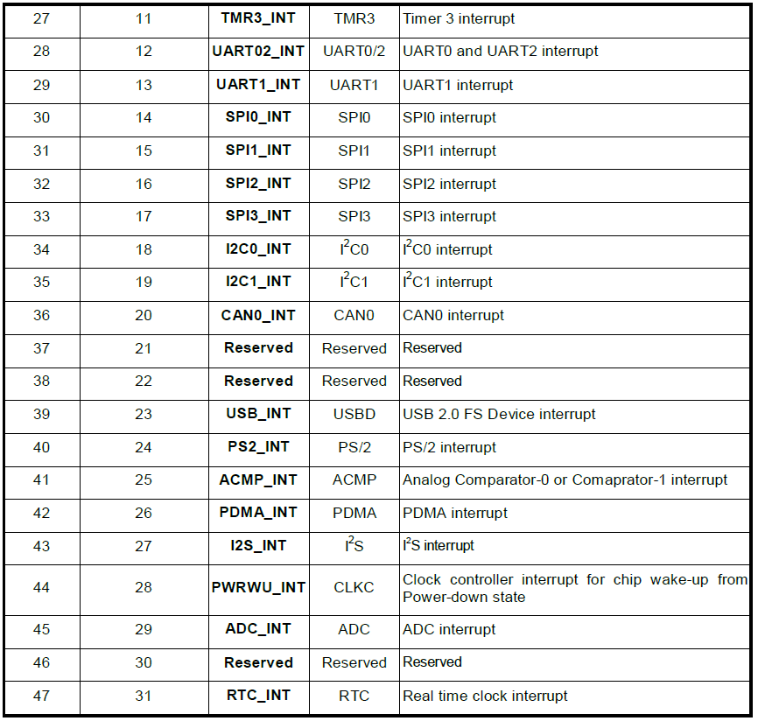
NUC140 System Interrupt Map
25

